Slide 1
HTML/CSS Workshop

Slide 2
What will we be building today?
A portfolio! Why?
Nowadays almost everything is done virtually. You need to be able to showcase your work online, especially during these times

Slide 3
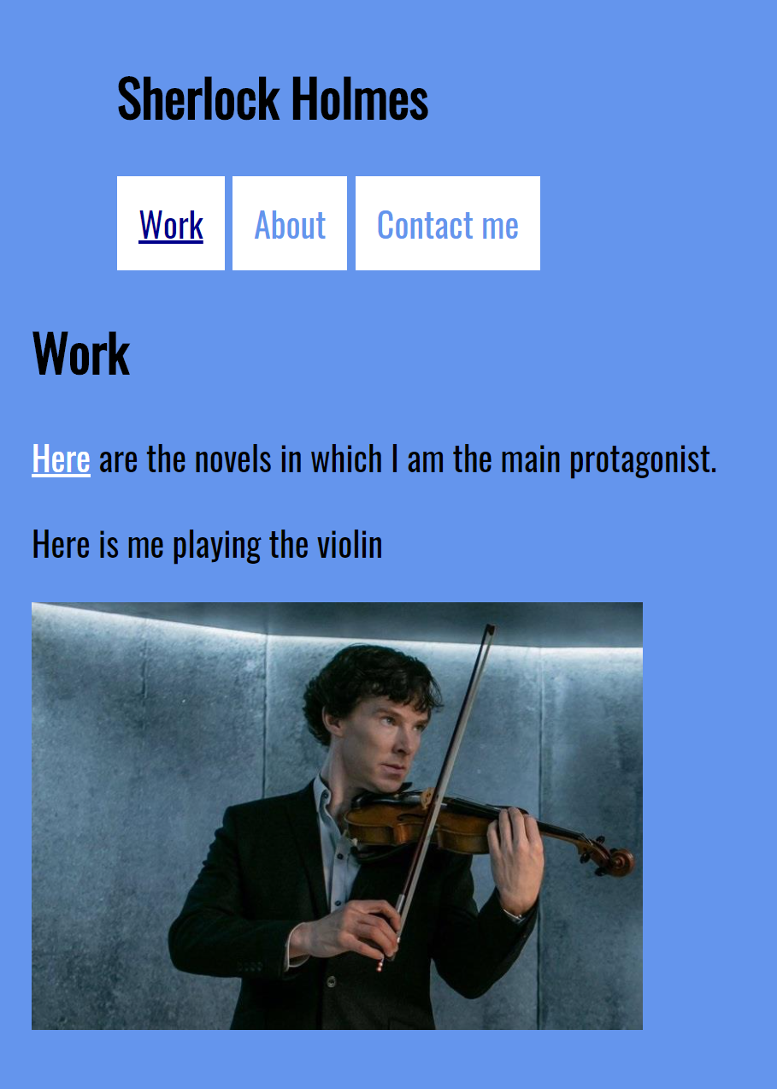
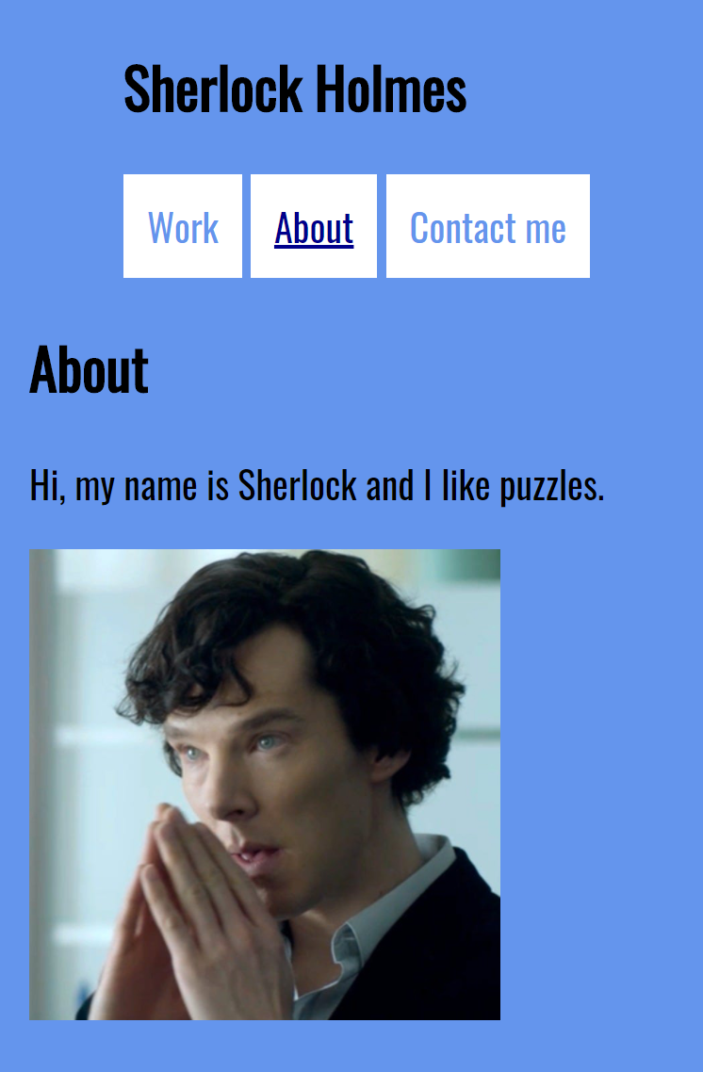
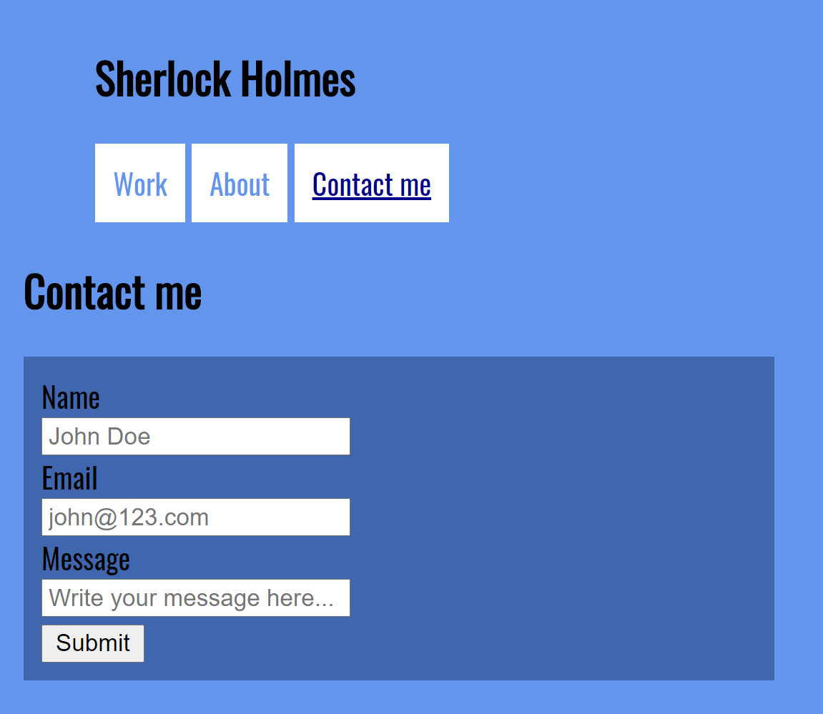
What do you need in a portfolio?
Work
About
Contact me

Slide 4
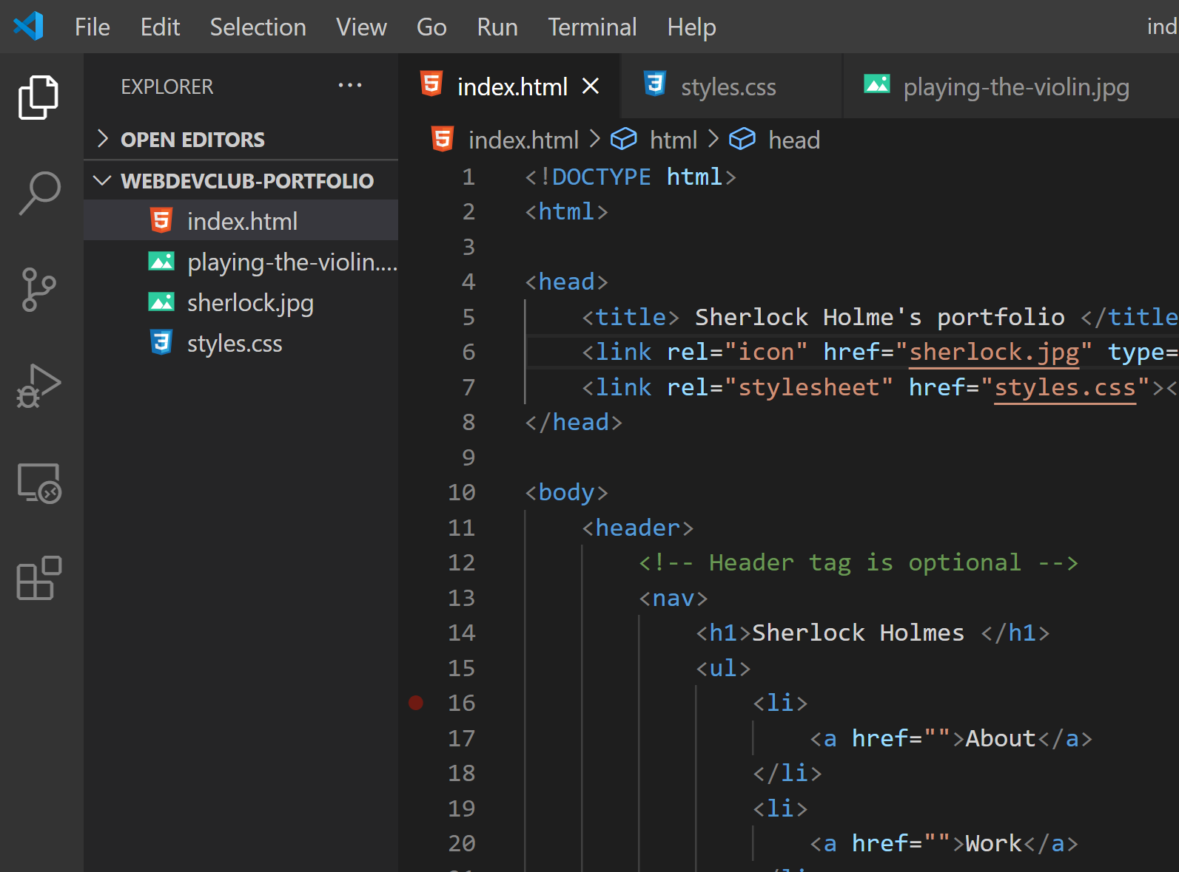
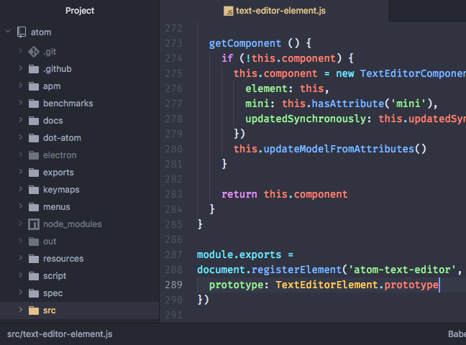
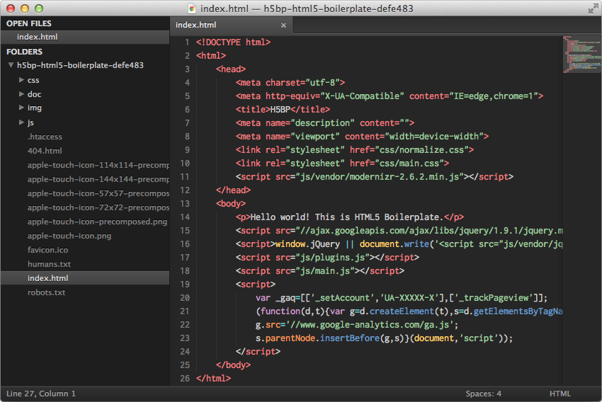
New to programming? What you need to get started
IDE: Integrated Development Environment
Software for building applications
For web development, here are some of the best IDEs
Visual Studio (or VScode)
Atom
Sublime
(All work on Windows and Mac)

Slide 5
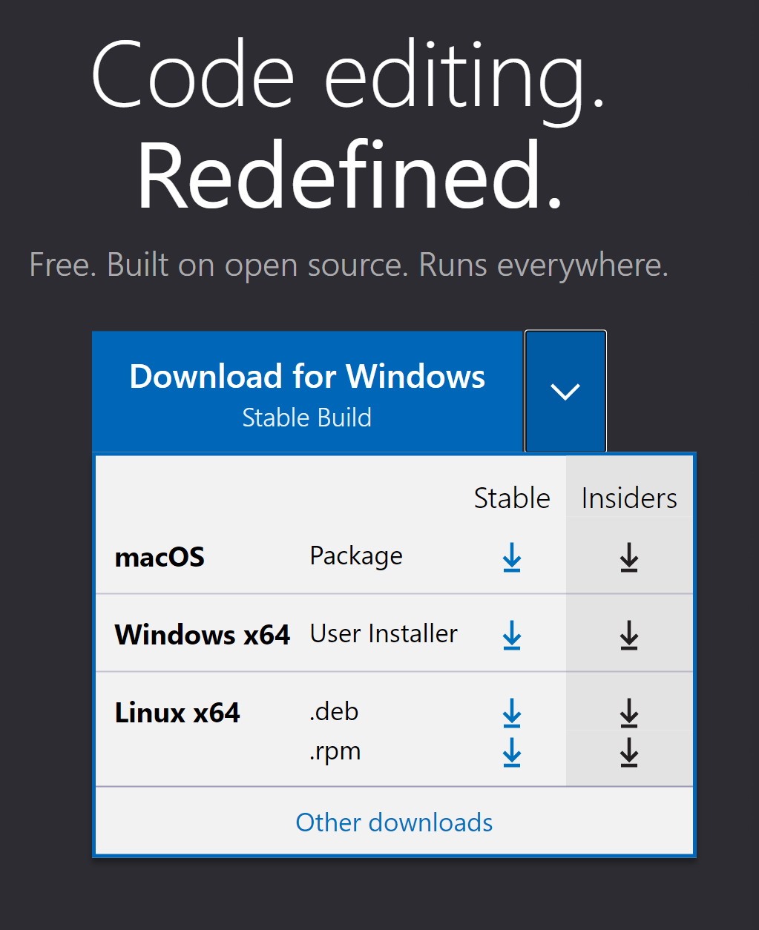
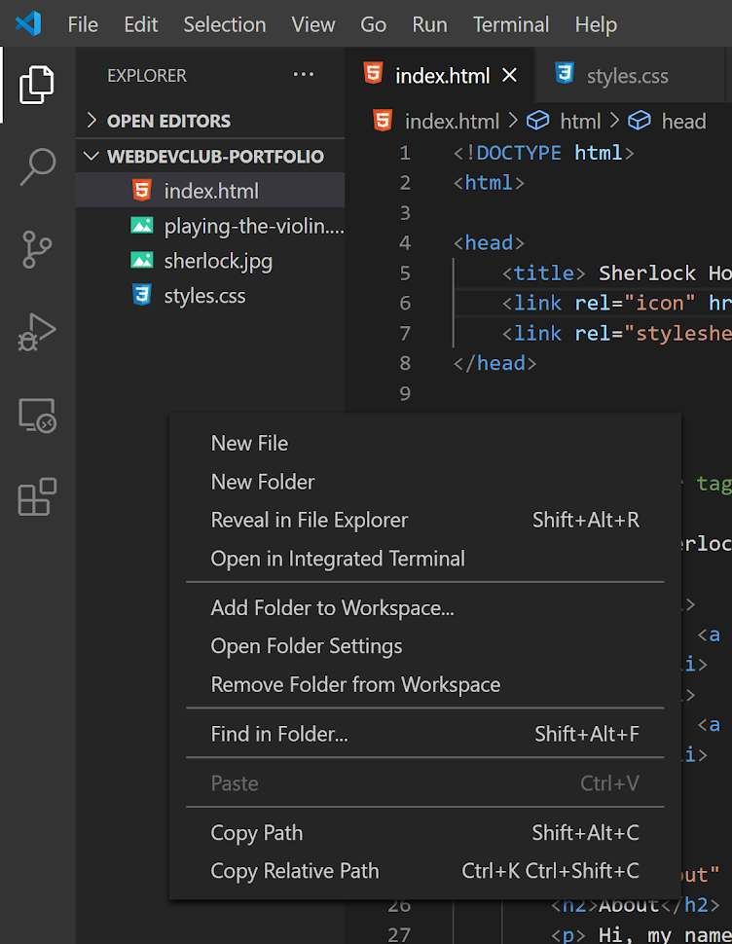
Download
Create a page
Name file index.html

Slide 6
How HTML works
<element> content </element>
Opening tag
Closing tag

Slide 7

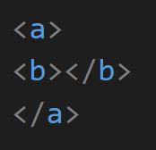
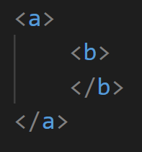
HTML works by nesting elements
=
=

Slide 8
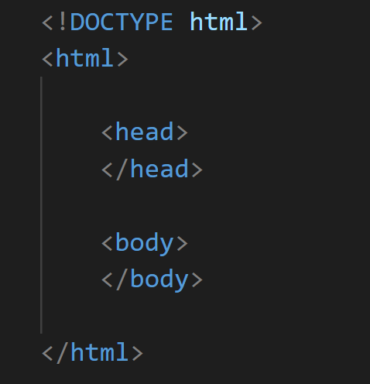
HTML building blocks
Once you have those, you can start building anything you want

Slide 9
HTML building blocks
TODO:
Copy the same element structure
Remember, spacing doesn’t matter
You just need to make sure each element has a closing tag

Slide 10
<head> elements
<title> Your website title </title>
<link rel="stylesheet" href="styles.css"></link>
<link rel="icon" href="icon.jpg" type=”image/gif” sizes=”16x16”></link>

Slide 11
<head> elements
Create a new file called styles.css
<title> Your website title </title>
<link rel="stylesheet" href="styles.css"></link>
<link rel="icon" href="icon.jpg" type=”image/gif” sizes=”16x16”></link>
Find an image to use for your website, place it in the same folder as your index.html and paste the name in this link

Slide 12
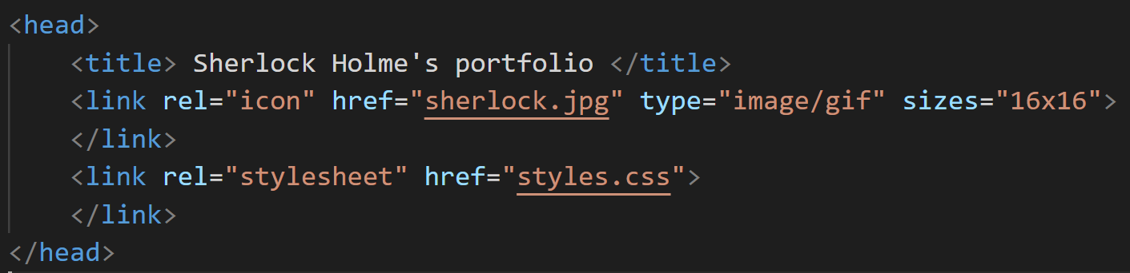

<head> example: Does your <head> look similar to this?
Open your html file in the browser by copying the path and look at the tab’s name. It should look like this

Slide 13
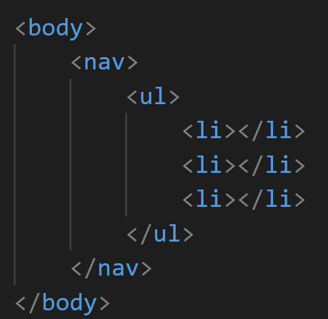
<body>: Where all the content goes
Navigation menu
<ul> : Unordered List
<li> : List item

Slide 14
<body>: Where all the content goes
Navigation menu
We need to create additional pages for our about and contact me sections
TODO: Create an about.html and contact.html page

Slide 15
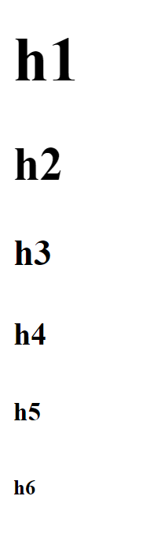
<body>: Where all the content goes
Navigation menu
<h1>Text</h1>
Write your name using the header size you prefer in the <ul> element

Slide 16
<body>: Where all the content goes
Navigation menu
See html file paths(1) for an explanation regarding “./”
<li><a href="./index.html"></a></li>
Stands for anchor
Repeat for about and contact page
https://www.w3schools.com/html/html_filepaths.asp

Slide 17
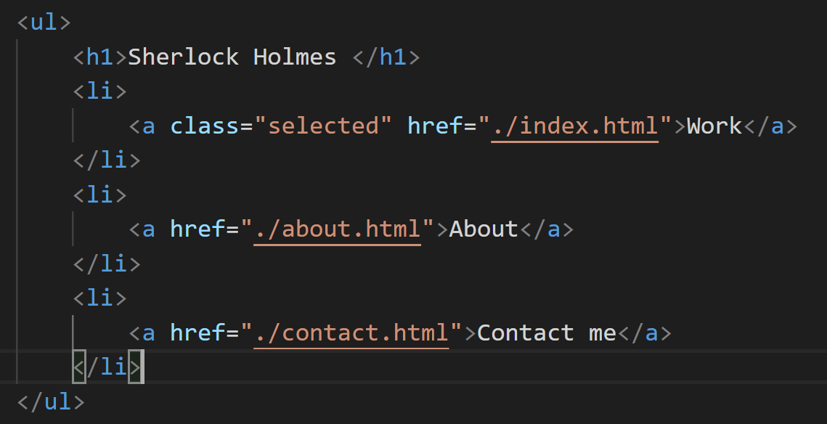
<body>: Where all the content goes
Navigation menu

Slide 18
About section
<h1> Name </h1>
<p> your bio </p>
<img src=”sherlock.jpg”></img>

Slide 19
<body>: Where all the content goes
Divs, or dividers with class attribute
<div class="work">div content</div>
Class can be selected to style the element
Todo:
Copy paste the content of index.html in about.html and contact.html
Create a div for each page with the classes ”work”, “contact” and “about”

Slide 20
Work section
Use <p></p> elements to describe your work
<a href="https://sherlock-holm.es/html/" target="_blank"></a>
<img src=”sherlock.jpg”></img>
<video width="320" height="240" controls>
<source src="movie.mp4" type="video/mp4">
</video>

Slide 21
Contact me
Form: <form></form>
<label></label>
<input type=”” placeholder=””></input>

Slide 22
CSS: include styles.css in HTML <head>
<link rel="stylesheet" href="styles.css">

Slide 23
CSS: selectors
body {
color: blue;
}
Try “cornflowerblue”, “blueviolet”, “greenyellow”,
“gold”....
.about {
background-color: blue;
}
Class selector always starts with “.”

Slide 24
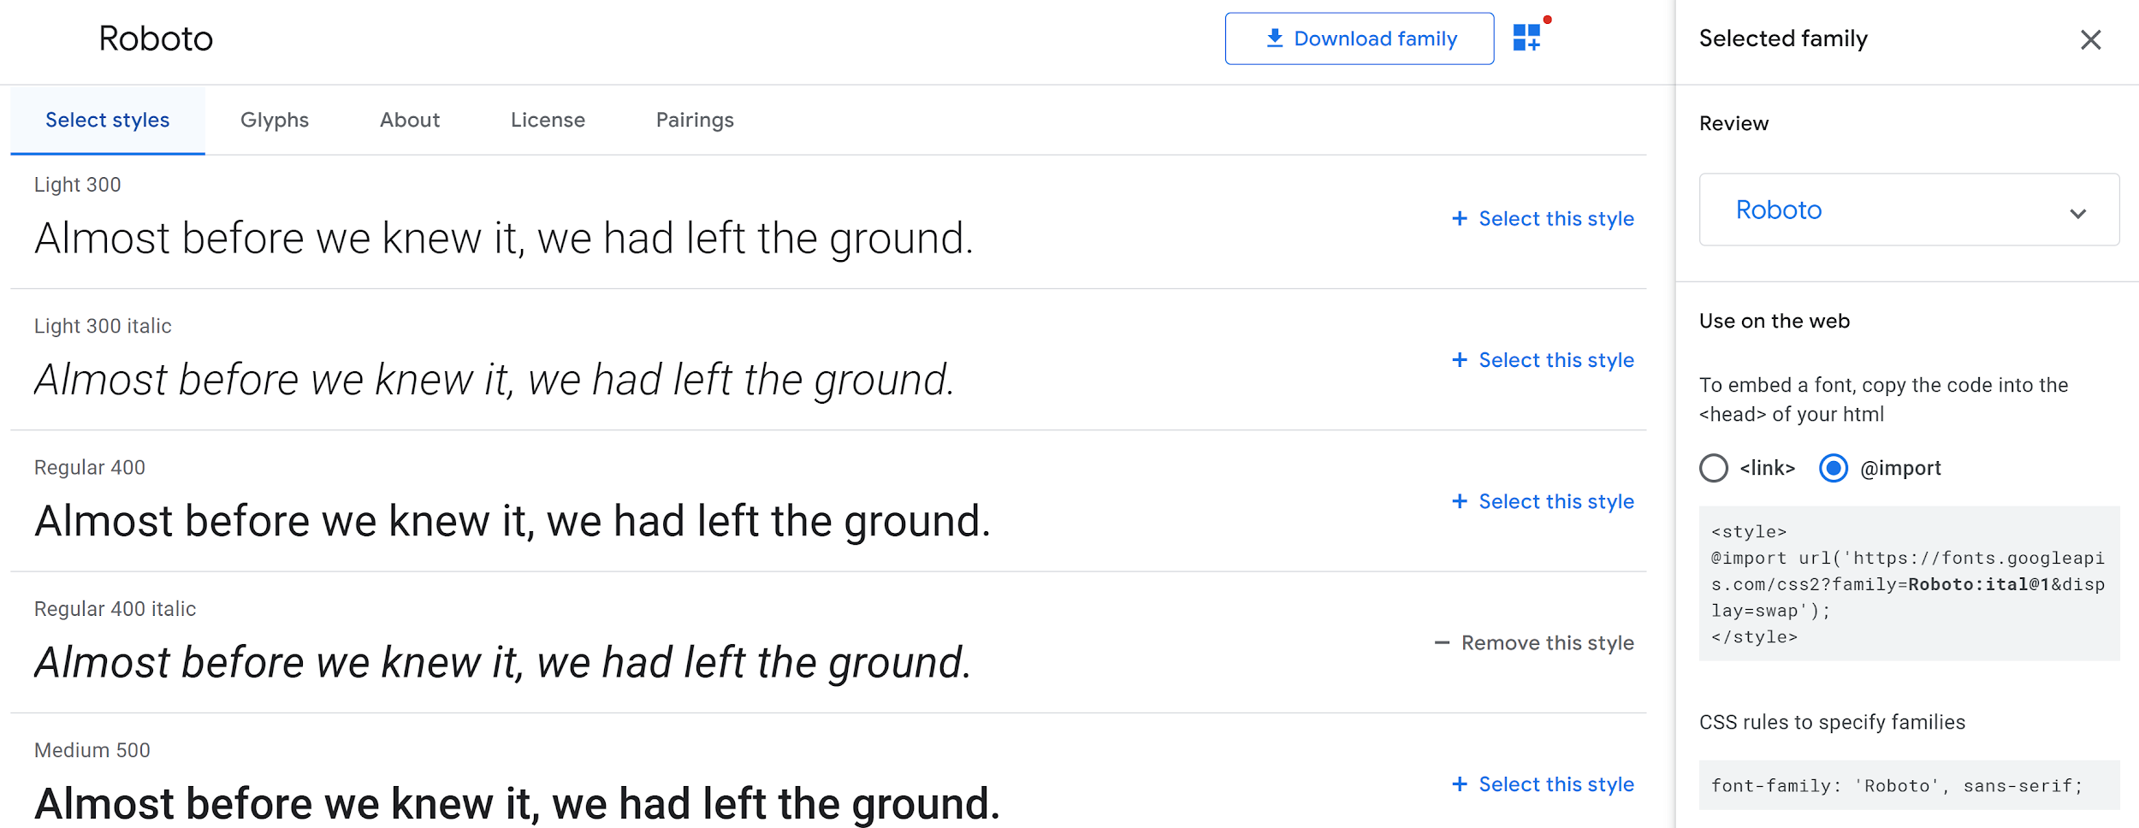
Font time!
https://fonts.google.com/
Pick a font you like and include it in your css file by placing it at the very top

Slide 25
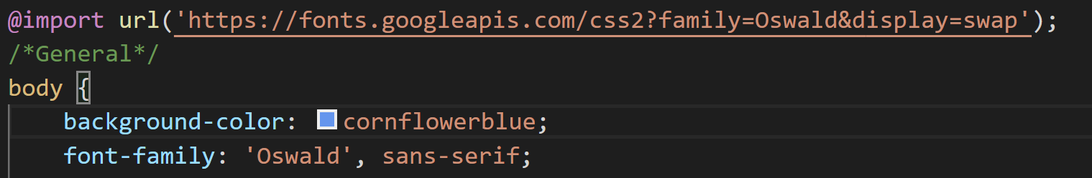
Font time!
https://fonts.google.com/

Slide 26
Custom navbar
Objectives:
1. Get rid of the bullet points
2. Have all elements be inline
3. Additional styling
ul{
list-style-type: none;
}

Slide 27
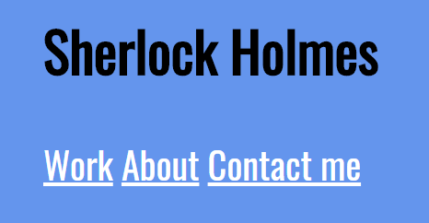
Custom navbar
Result:
Objectives:
1. Get rid of the bullet points
2. Have all elements be inline
3. Additional styling
2. ul li {
display: inline-block;
}

Slide 28
Custom navbar
li {
padding:10px;
background-color: white;
color: black;
}
li a{
text-decoration: none;
color: cornflowerblue;
}
Objectives:
1. Get rid of the bullet points
2. Have all elements be inline
3. Additional styling
For each page menu, I assign a “selected” class to the menu link I am currently visiting and apply styling
.selected{
color: darkblue;
text-decoration: underline;
}

Slide 29
And...voila! Next steps?
Javascript for dynamic web pages
Web hosting
Web design
User experience (UX)
The slides will be sent to you using the email you provided in the signup link. If you did not sign up beforehand, send me an email at @vbeaufil@purdue.edu. The same applies if you have any questions!

